Slide 1

Python Programming: Midterm & Finals Presentation
Jayashree JOHNSON
11/15/2024 & 12/06/2024

Slide 2
Agenda
NYPD Complaint Historic Data
Exploratory Data Analysis Summary
Data Inspection
Data Cleaning
Feature Engineering
Data Visualization
Key Takeaways
Conclusion
Future Analysis

Slide 3

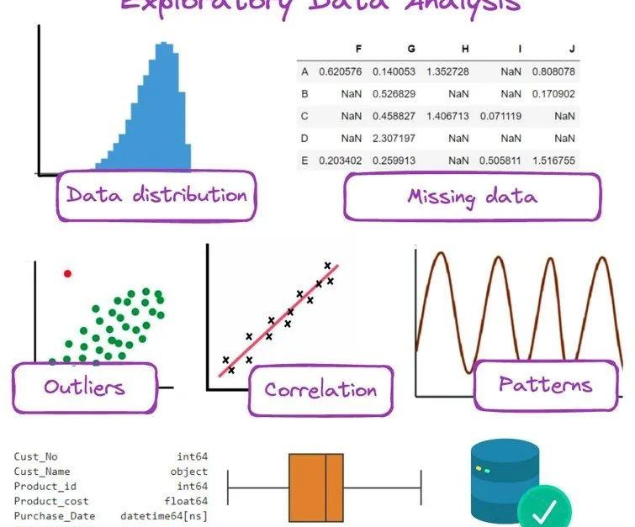
NYPD Complaint Historic Data
https://data.cityofnewyork.us/Public-Safety/NYPD-Complaint-Data-Historic/qgea-i56i/data
Overview of this Dataset
Why this dataset?
Key Benefits

Slide 4

Overview of the Dataset (2021-2024)
⁠Description: This dataset contains NYPD complaint data covering incidents from May 1, 2021, to May 1, 2024, including details on reported crimes such as offense type, location, time, and demographics of involved individuals.
Timeframe Rationale: The specific timeframe focuses on recent crime patterns, allowing analysis of current trends without outdated data, essential for understanding today’s crime landscape in New York.

Slide 5
Why this dataset?
Current Relevance: Analyzing recent data allows us to identify present-day crime trends, directly relevant to today’s social conditions and urban planning needs.
Post-Pandemic Impact: This timeframe captures socio-economic changes post-COVID-19, a period marked by shifts in crime dynamics due to altered social and economic factors.
Rich Detail: The dataset includes specific times, dates, and demographic details, allowing for comprehensive analysis of each incident. This depth of information reveals insights into the distribution of crime across neighborhoods, age groups, and times.
Dynamic Patterns: Covering recent years, the dataset captures evolving crime trends, making the analysis both timely and actionable.
Real-World Impact: This dataset highlights the real-world application of data science, as the insights derived from this analysis can directly contribute to public safety and community well-being.

Slide 6
Key Benefits
Data for Prediction Models: The data supports predictive analytics and machine learning models to help forecast crime patterns and inform prevention strategies.
Public Awareness: Analyzing recent crime data raises public awareness about current crime rates and trends, which helps communities take proactive safety measures.

Slide 7

Exploratory Data Analysis (EDA)
EDA serves as a foundational step to understand the dataset’s structure, check data quality, and prepare it for further analysis.
Our EDA process starts with Data Inspection, where we analyze dataset dimensions, data types, and statistical summaries, providing an initial sense of its content and quality. Following this, Data Cleaning ensures reliability by addressing missing values and other inconsistencies.
After cleaning, Feature Engineering allows us to create additional attributes, such as categorizing crime incidents by time of day or extracting specific crime types, enabling more nuanced analysis. Once new features are prepared, Data Visualization helps us explore patterns and relationships across variables, such as the distribution of crimes by borough and time, as well as potential correlations between variables.

Slide 8

Data Inspection: df.info() The dataset contains 1,340 records and 35 features. Each feature has a specific data type, such as integers, floats, or objects (strings), which describes the nature of data contained within each column. This overview also provides the non-null count for each feature, allowing us to quickly assess the presence of missing values across columns.

Slide 9
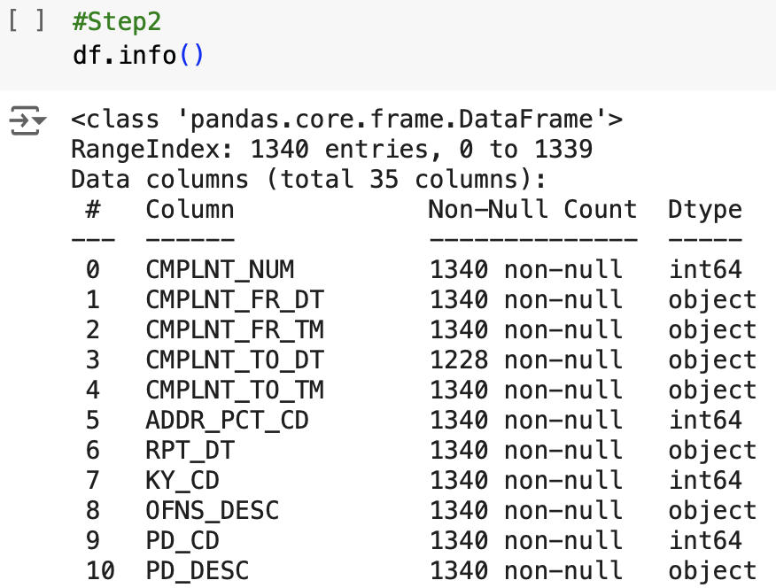
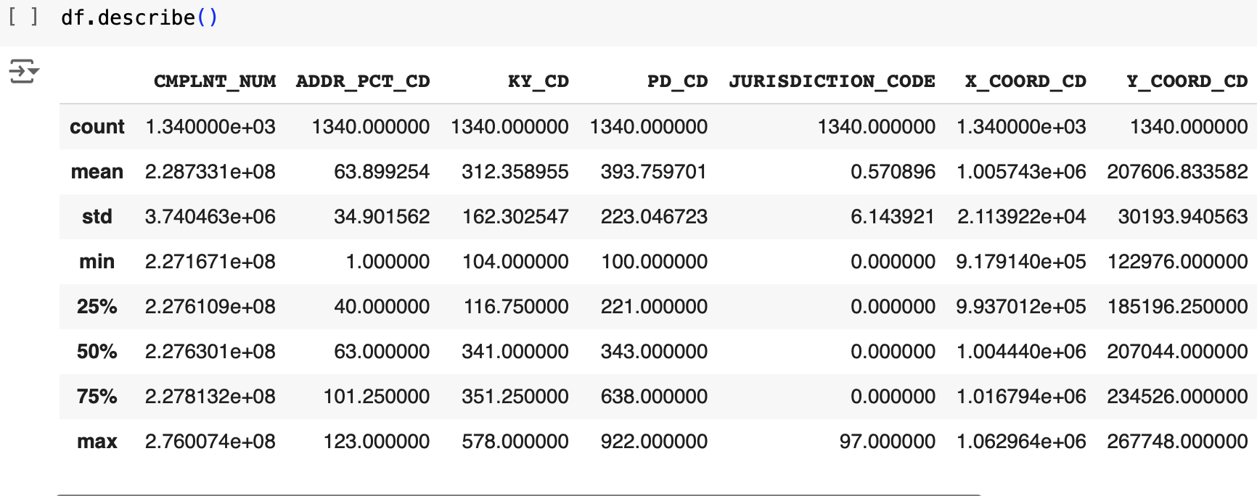

Slide 10
df.describe()
The descriptive statistics summary provides insights into numerical features through metrics such as:
Count: Number of non-missing entries per feature.
Mean: Average value within each column.
Standard Deviation: Dispersion of values around the mean, indicating variability.
Minimum and Maximum: The range of values for each feature.
Percentiles (25%, 50%, 75%): Distribution insights, dividing data into quarters.
These metrics help identify the range, central tendency, and spread of numerical data.

Slide 11
Contd.,
df.shape()
The dataset has 1,340 rows and 35 columns, indicating its size and dimensionality.
df.isnull().sum()
This analysis highlights the number of missing values for each feature.
Identifying features with missing values is crucial for determining data cleaning requirements, as handling these missing values is essential for accurate analysis.
df.sum(numeric_only=True)
This calculation provides the aggregate total for each numeric column, offering a quick reference for identifying data scale and potential anomalies.
Summing numeric values can reveal irregularities or unexpected totals, signaling data quality issues if present.

Slide 12
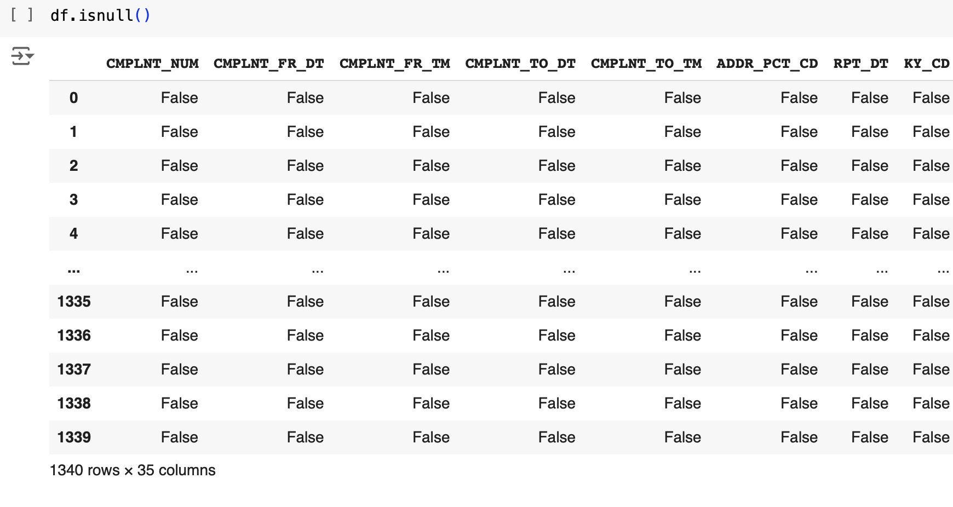
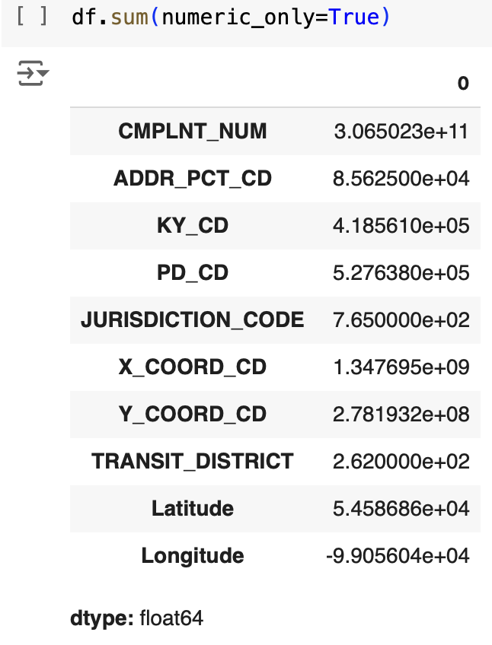

Slide 13
The goal of data cleaning is to identify and rectify inaccuracies, inconsistencies, and missing values within the dataset to ensure its reliability and suitability for analysis.
Identifying Missing Values:
Utilizing the df.isnull().sum() function, we assessed the dataset for missing values. This revealed that the CMPLNT_TO_DT column had 112 missing entries, and TRANSIT_DISTRICT with 1317 missing values, necessitating appropriate handling to maintain data integrity.
Data Cleaning

Slide 14
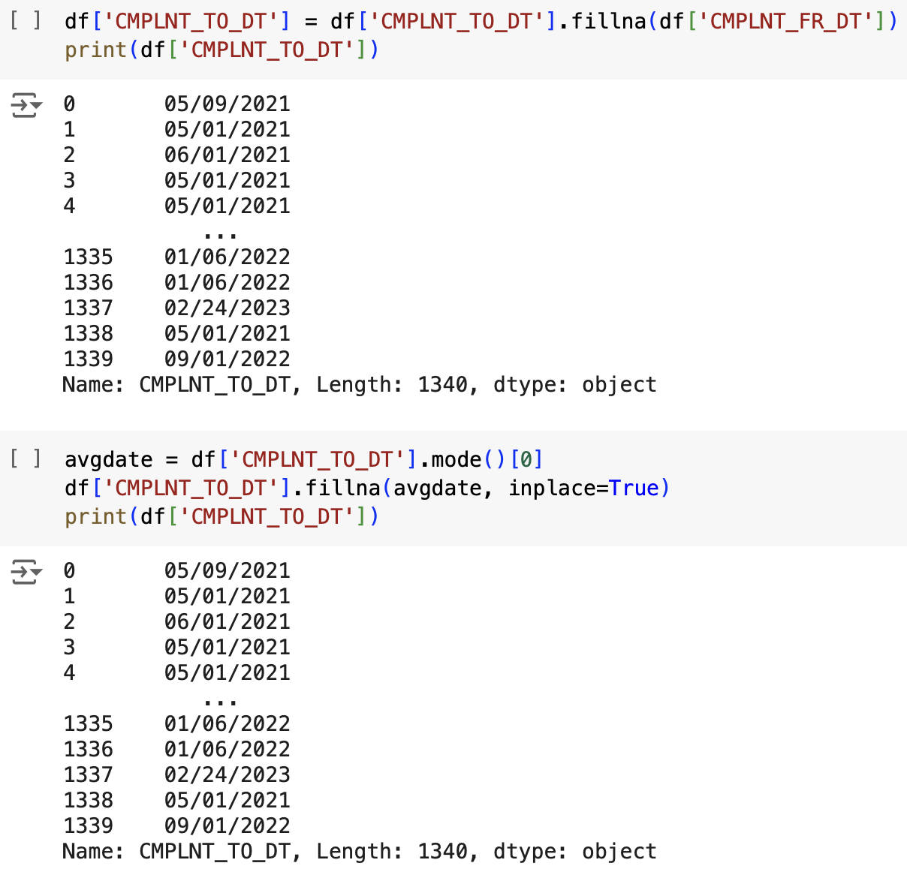
Handling Missing Values: CMPLNT_TO_DT

Slide 15
Contd.,
Filling with CMPLNT_FR_DT: In cases where the end date (CMPLNT_TO_DT) was missing, I substituted it with the corresponding start date (CMPLNT_FR_DT). This approach assumes that if the end date is absent, the incident likely occurred and concluded on the same day.
Filling with the Mode: Alternatively, I replaced missing CMPLNT_TO_DT values with the mode—the most frequently occurring date in this column. This statistical method provides a consistent replacement, especially when no specific end date information is available

Slide 16
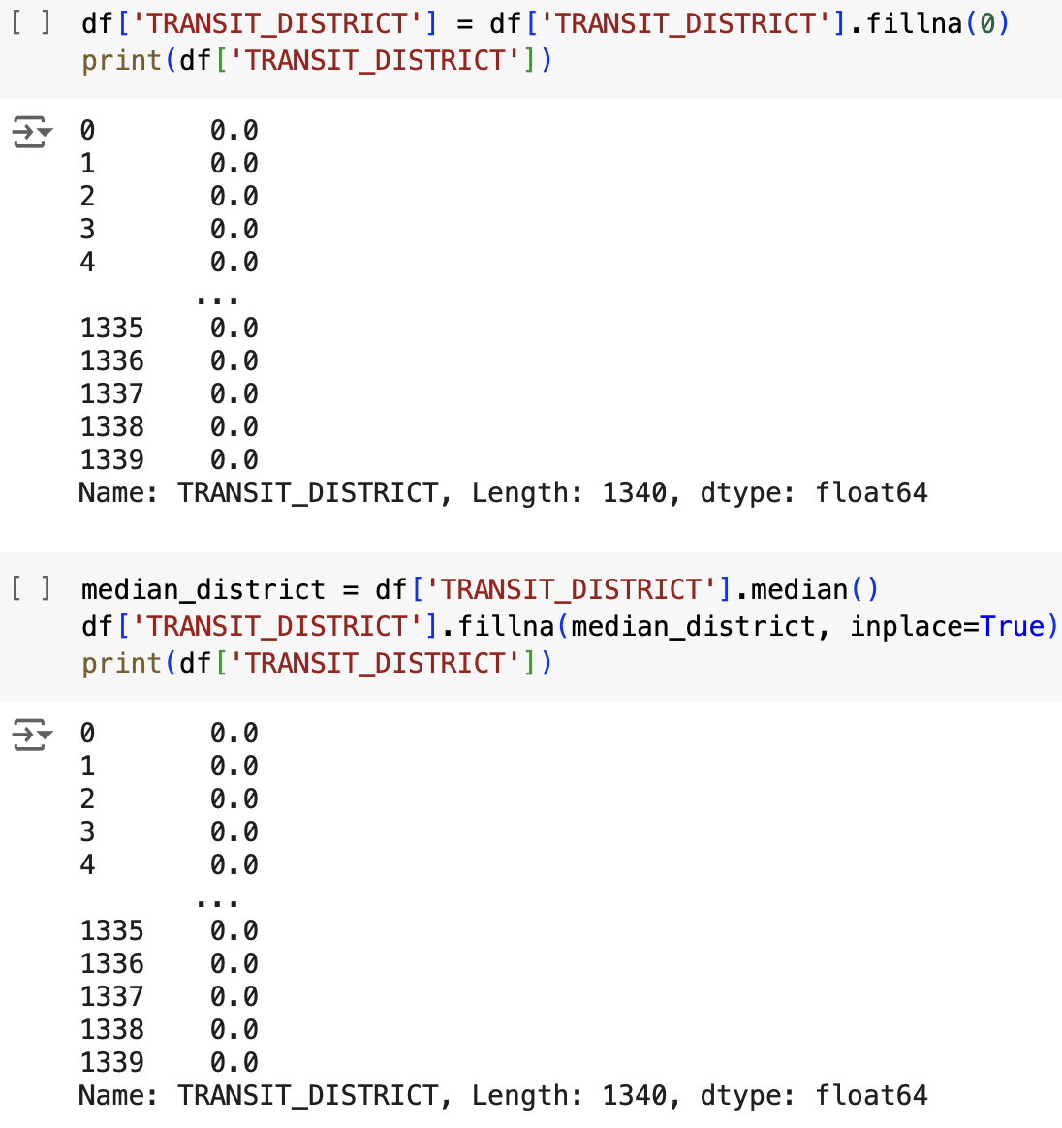
Handling Missing Values: TRANSIT_DISTRICT

Slide 17
Contd.,
Filling with Zero: The first approach involved filling the missing values in TRANSIT_DISTRICT with 0. This was used to indicate that there was no specific transit district data for those entries. This approach is straightforward and keeps the missing values identifiable without introducing additional assumptions.
Filling with Median: As an alternative, the missing values were filled with the median value of TRANSIT_DISTRICT. This method is beneficial because the median is less sensitive to outliers than the mean, offering a central value that can make the dataset more consistent without skewing the data.

Slide 18
Feature Engineering
Objective:
The goal of feature engineering is to create new features from existing data that enhance the dataset’s analytical value. This step helps prepare the data for deeper analysis and ensures that key temporal and categorical insights are included in the dataset.

Slide 19
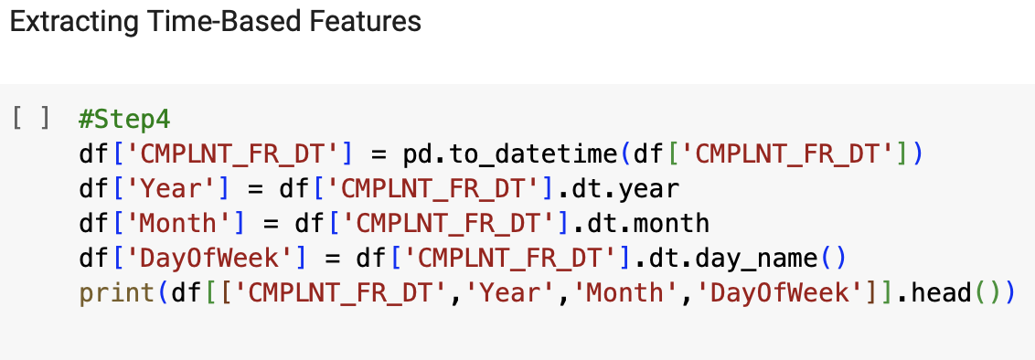
Extracting Time-Based Features:
Converted CMPLNT_FR_DT (complaint start date) to extract components like Year, Month, and Day of the Week.
This allows us to analyze crime patterns by specific time intervals, which could reveal trends such as seasonality or daily/weekly crime patterns.

Slide 20
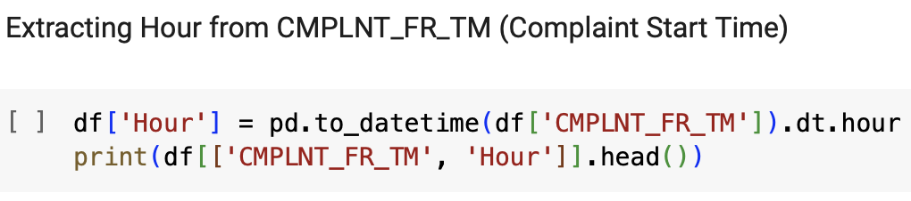
Extracting Hour from Complaint Start Time:
Retrieved the Hour from CMPLNT_FR_TM to analyze crime incidence during different times of the day.
Understanding hourly trends helps identify peak hours for different types of crimes.

Slide 21
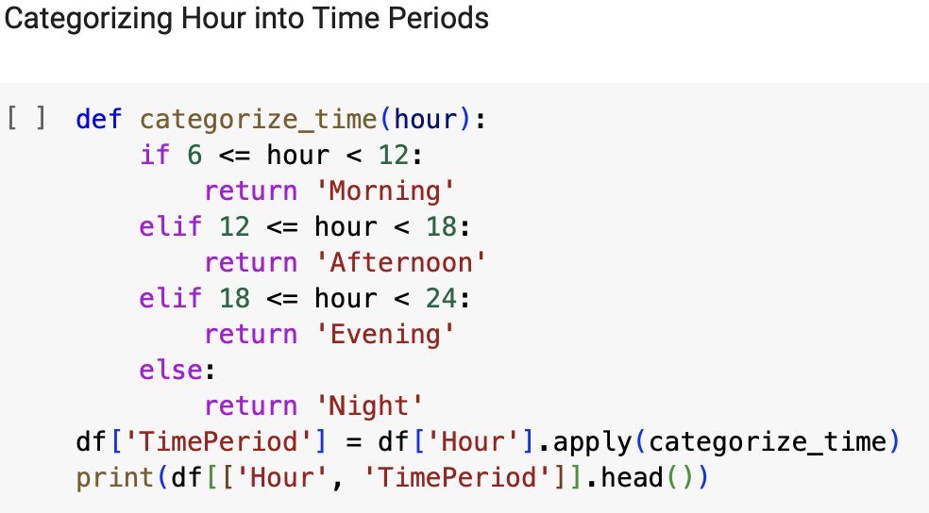
Categorizing Time Periods:
Grouped hours into time periods (Morning, Afternoon, Evening, and Night) to simplify the analysis of crime rates at different times of the day.
This categorization enables easy comparison and visualization of crime distribution across these time intervals.

Slide 22
Data Visualization
Univariate Analysis
Bivariate Analysis
Purpose: Focused on examining each variable in the dataset individually. The goal is to understand the distribution, central tendency, and variability of a single variable at a time.
Description: In this analysis, we explore individual variables to observe their patterns and characteristics. This approach allows us to identify general trends, such as which crime types are most common or which boroughs report higher incidents.
Purpose: Aims to explore relationships and interactions between two variables. This analysis helps us understand if and how two variables are related.
Description: By examining pairs of variables, we gain insight into the relationships within our dataset, allowing us to observe how one variable might influence or correlate with another.

Slide 23
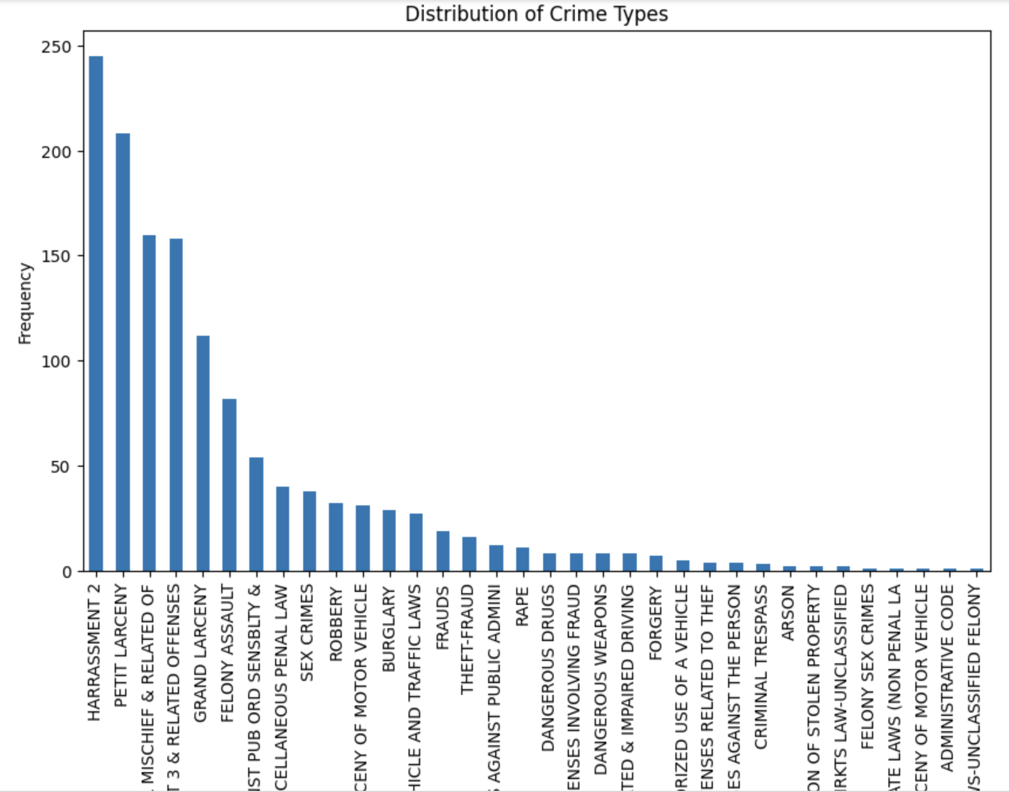
Univariate Analysis: Visualization

Slide 24
Observation
Frequent Crime Types: Harassment, Petit Larceny, and Assault are the most common crime types, as shown by the highest frequencies in the chart.
Lesser Common Crimes: Offenses like Unauthorized Use of a Vehicle, Felony Sex Crimes, and Arson appear with relatively low frequencies, suggesting these are less frequent occurrences.
Pattern Recognition: The data allows for recognition of patterns in criminal activity types, which can help in resource allocation and policy-making to address the most common crimes effectively.

Slide 25
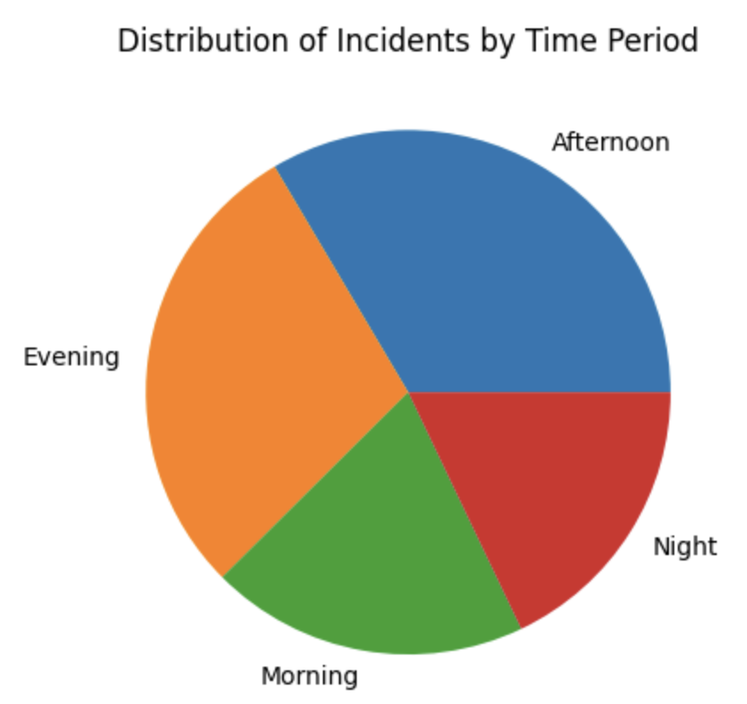
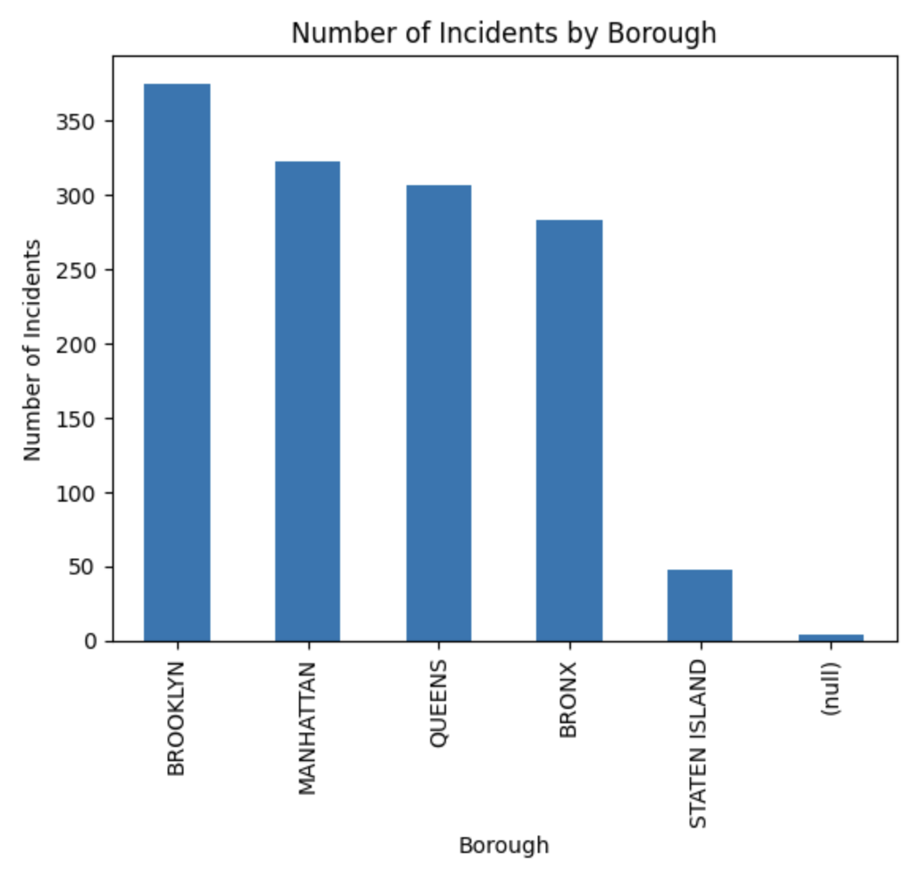
Contd.,

Slide 26
Observation
Pie Chart: Distribution of Incidents by Time Period
Key Finding: The chart reveals that crime incidents are most frequent in the afternoon, followed by evening, with fewer occurrences in the morning and night.
Insight: This pattern suggests that criminal activities may correlate with higher public activity levels during specific times of day.
Bar Chart: Number of Incidents by Borough
Key Finding: Brooklyn records the highest number of incidents, followed closely by Manhattan and Queens, while Staten Island has the fewest.
Insight: Crime distribution varies significantly across boroughs, indicating potential socio-economic or environmental factors that influence crime rates.

Slide 27
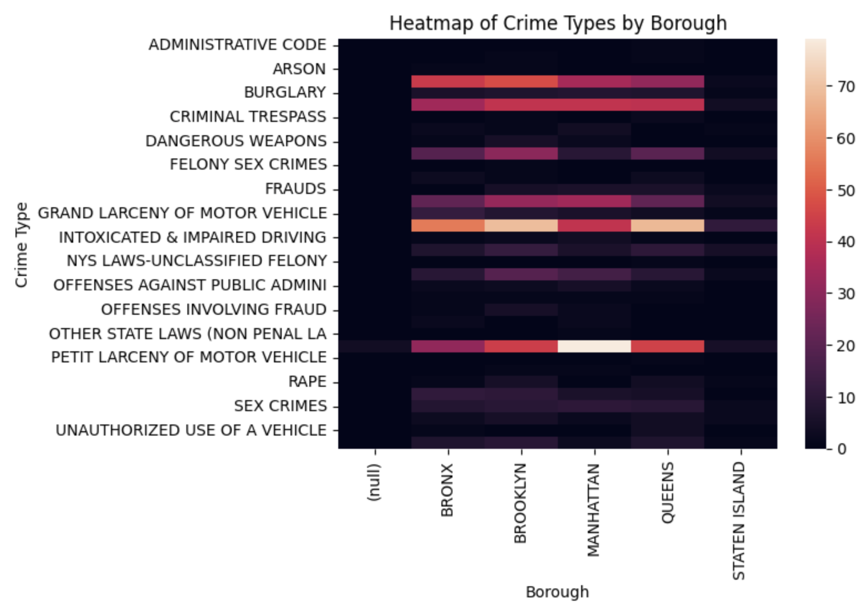
Bivariate Analysis: Visualization

Slide 28
Observation
Petit Larceny is highly prevalent in Manhattan, as indicated by the lightest shades in that borough, showing it is the most frequently reported crime there.
Harassment and Assault also appear frequently in Manhattan, evidenced by their lighter shades, reflecting a higher occurrence rate compared to other boroughs.
Bronx has a moderate level of crime frequency across multiple types, such as burglary and robbery.
Queens and Brooklyn show similar patterns of crime incidence, with varied shades suggesting specific crimes like fraud or motor vehicle theft are more common in these areas.
Staten Island generally exhibits darker shades across most crime types, indicating a lower crime frequency overall compared to other boroughs.
Rape and Serious Assaults appear distributed across boroughs with varied frequency, highlighting the need for targeted intervention in areas with lighter shades for these serious offenses.

Slide 29
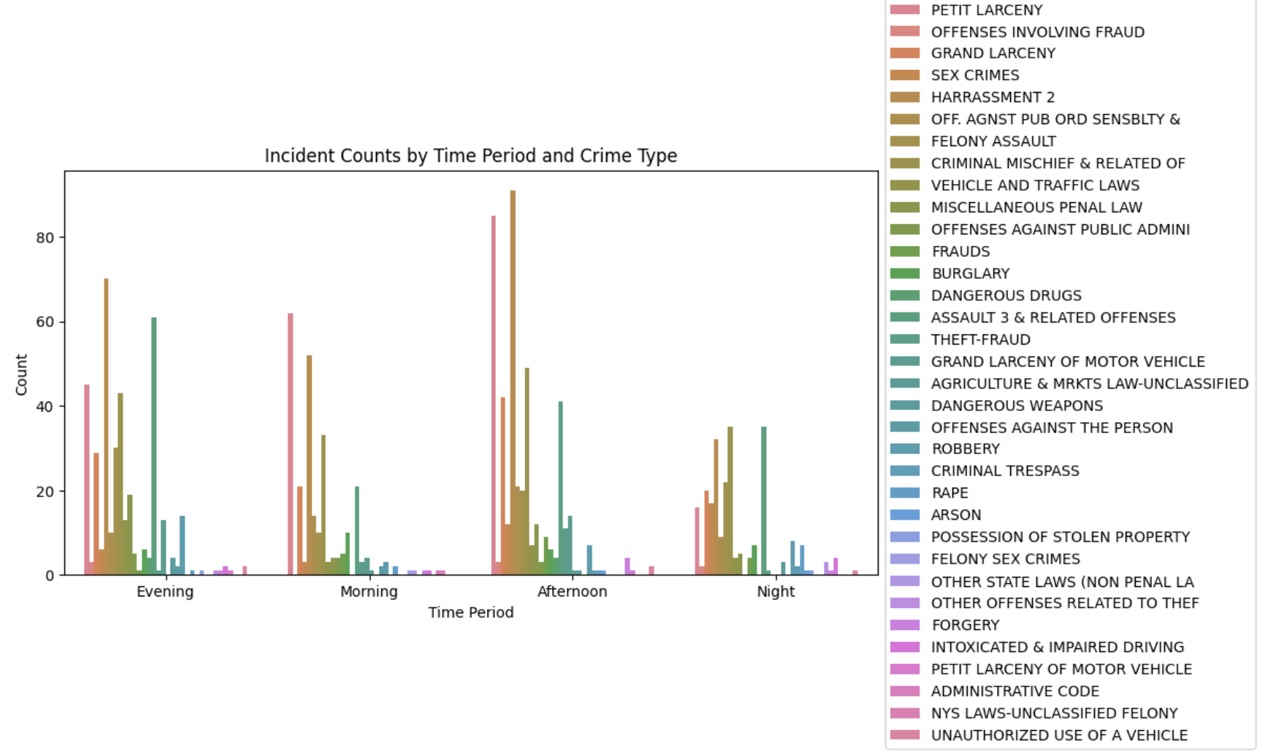
Contd.,

Slide 30
Observation
Peak in the Afternoon: The afternoon period exhibits the highest concentration of incidents across various crime types, indicating that this time is particularly active for criminal activity.
Petit Larceny Dominance: Petit larceny incidents are consistently high across all time periods, especially in the afternoon and evening. This trend suggests that theft-related crimes are a recurring issue throughout the day.
Crime Type Variation by Time: Certain crimes, like harassment and assault, show higher frequencies in the evening, while others, such as grand larceny, peak during the afternoon. This reflects distinct patterns in when specific types of crimes are more likely to occur.
Lower Incidents at Night: The night period shows a generally lower count across most crime types, potentially indicating effective deterrents or reduced opportunity for certain crimes during this time.
Unique Trends for Specific Crimes: Some crime types, like burglary and vehicle-related offenses, appear to spike during particular times, reflecting targeted periods for these activities.

Slide 31
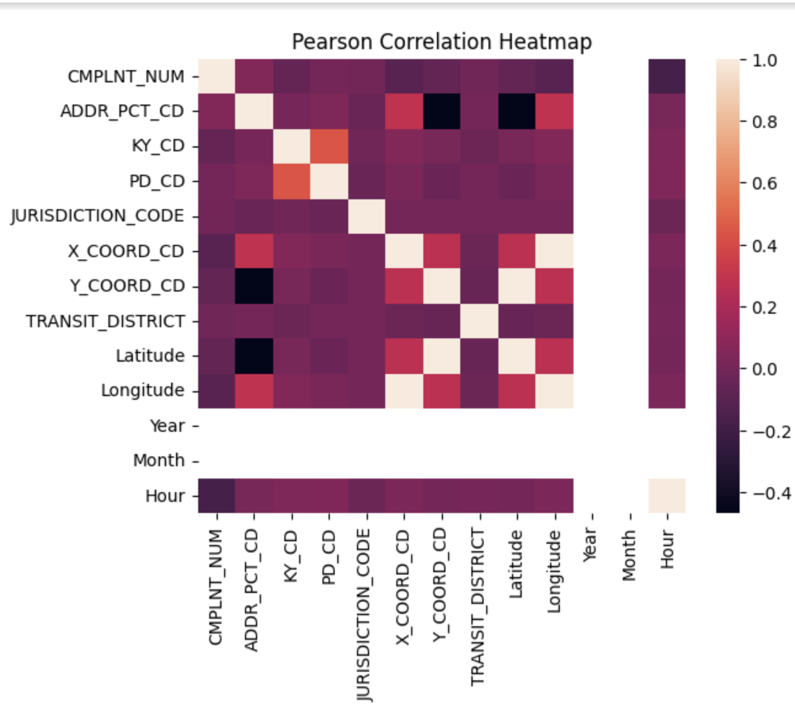
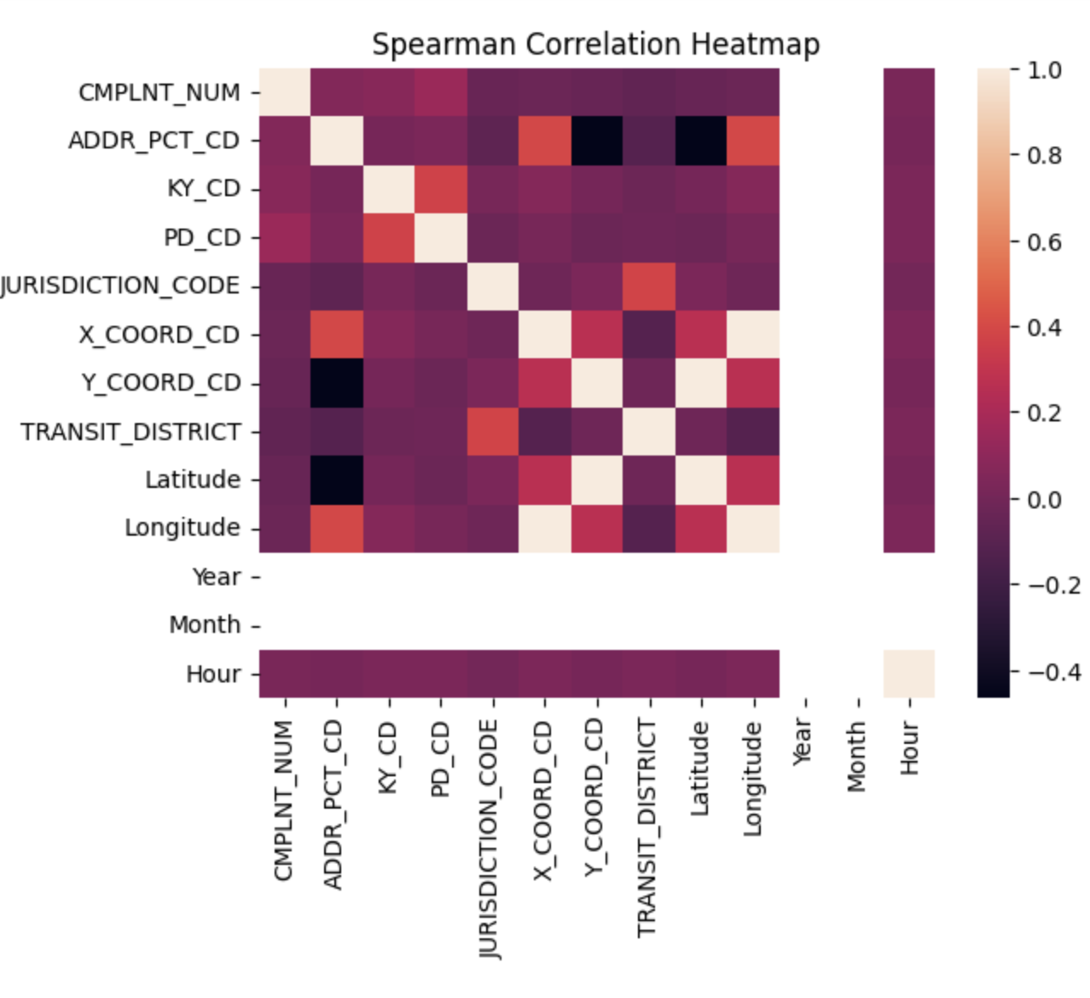
Contd.,

Slide 32
Pearson Correlation Observation
What relationships exist between various factors like location, time, and crime type?
Strong positive correlations are observed between X_COORD_CD and Y_COORD_CD (0.78), suggesting crime incidents tend to cluster in certain areas.
ADDR_PCT_CD and TRANSIT_DISTRICT show moderate correlation (0.54), indicating a link between precincts and transit areas.
Latitude and Longitude exhibit a near-zero correlation (-0.02), implying minimal direct relationship between these geographic features.

Slide 33
Spearman Correlation Observation
X_COORD_CD and Y_COORD_CD maintain a strong positive correlation (0.80), reinforcing the geographic concentration pattern, where incidents cluster within certain areas.
ADDR_PCT_CD also shows a notable correlation with TRANSIT_DISTRICT (0.52), aligning with precinct distributions relative to transit areas.
CMPLNT_NUM and ADDR_PCT_CD exhibit a slight positive correlation (0.13), which may suggest a weak association between complaint records and precinct locations.
Time Features: The correlation between Year, Month, and Hour suggests some consistency in incident frequency across time, though these correlations are weaker than those seen with location-based features.

Slide 34
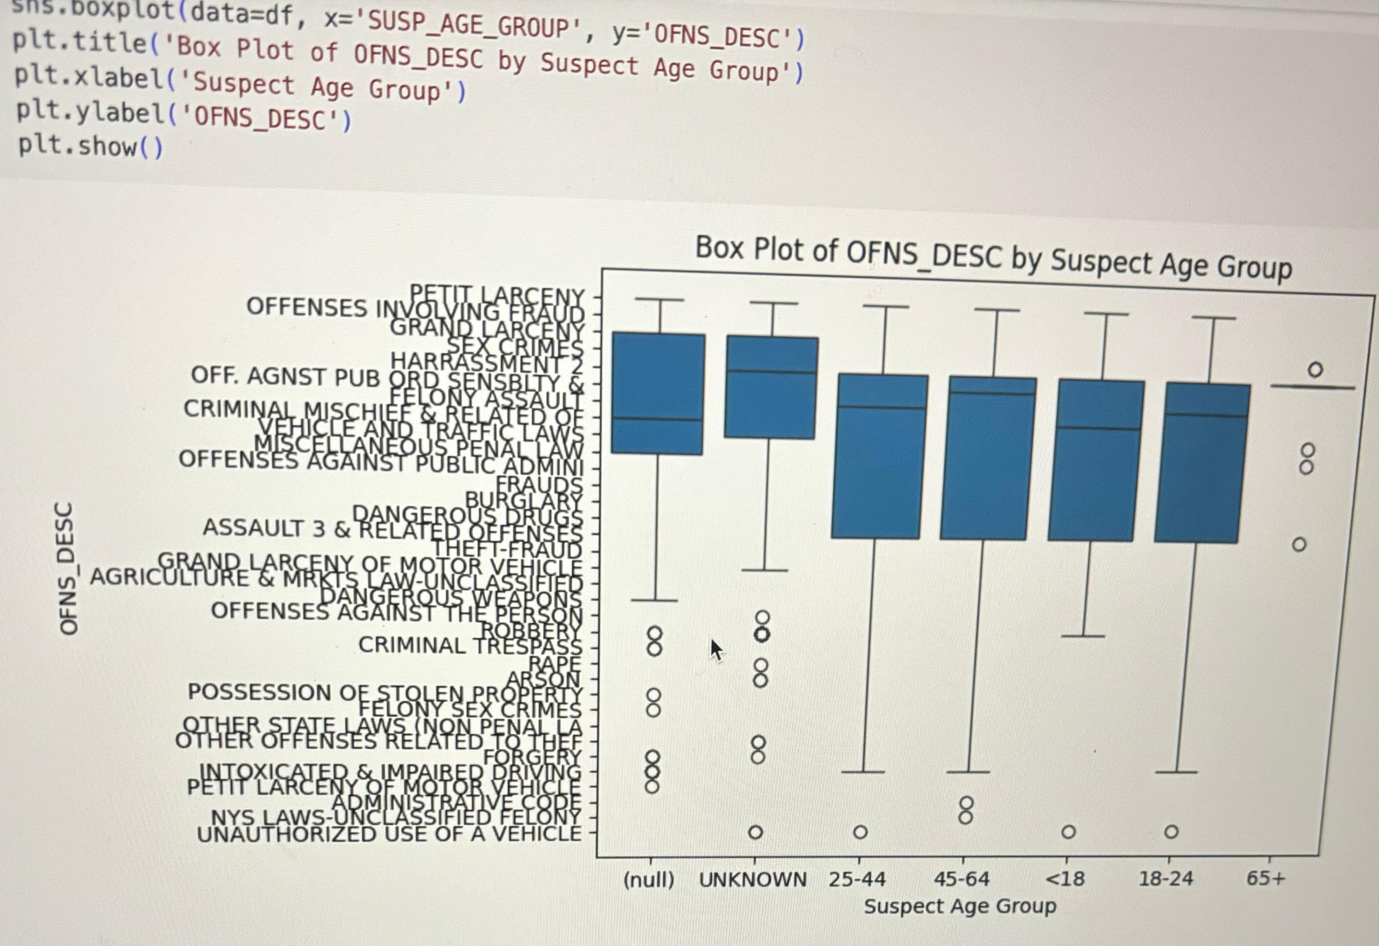
Contd.,

Slide 35
Observation
Age Group ‘Unknown’: The ‘Unknown’ age group has a wide range of offense types, suggesting that cases with unspecified age are more varied in nature. This group shows more variability and some outliers, indicating a broad distribution of offenses.
Young Adults (18-24): Offenses committed by young adults (18-24) seem relatively consistent across types, with a smaller spread, indicating that they might be involved in certain types of crimes more frequently than others.
Older Adults (45-64): The age group 45-64 has a slightly broader spread compared to younger adults, showing involvement in a wider variety of offense types.
Elderly Group (65+): The 65+ age group has limited data points, suggesting lower involvement in crime. This is expected, as older adults typically have lower crime rates.
Outliers by Age Group: Outliers appear across multiple age groups, especially within the ‘Unknown’ category. They represent specific offense types that are less common for the respective age groups. There are notable outliers in offenses like “Petit Larceny” and “Assault,” which may indicate that these offenses occur unexpectedly.

Slide 36
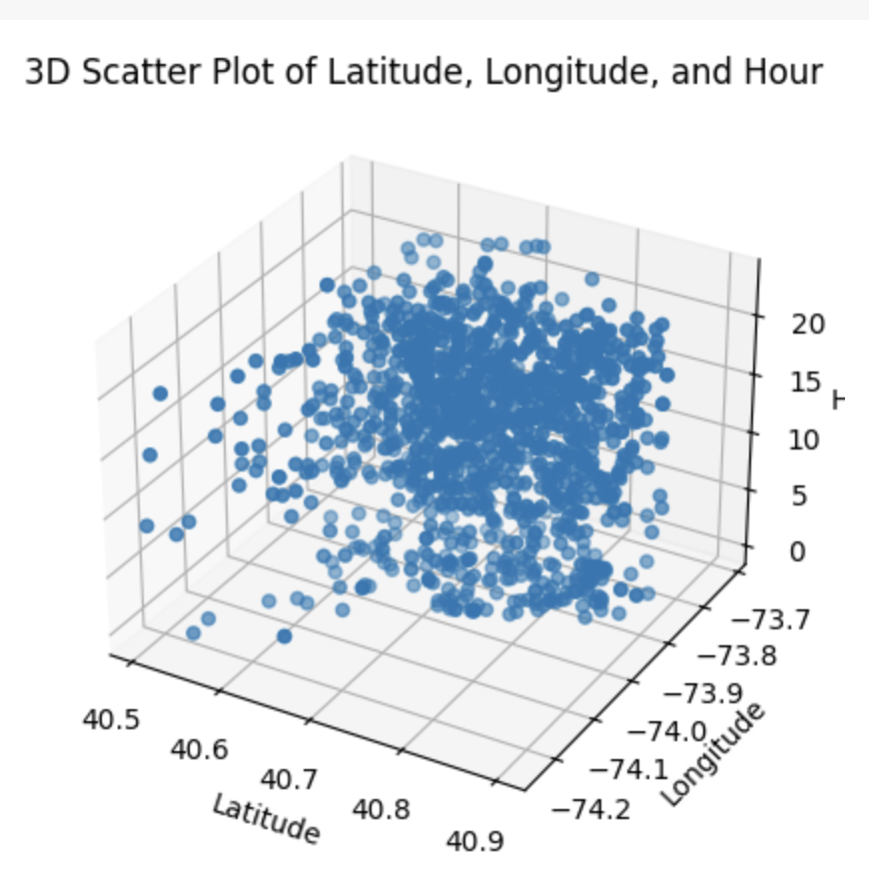
Contd.,

Slide 37
Observation
High-Incidence Locations:
Incidents are densely clustered around latitude 40.7 to 40.9 and longitude -73.9 to -74.1, indicating these geographical coordinates as high-crime areas.
Peak Crime Hours:
The distribution along the ‘Hour’ axis shows higher incident frequencies in the late evening to early morning hours, around 18:00 to 02:00, suggesting that crime rates may be elevated during these times.
Hotspots:
Combining location and time, the highest concentration of incidents occurs around latitude 40.7 to 40.9 and longitude -73.9 to -74.1 during the evening and night hours, highlighting this range as a critical hotspot for targeted interventions.

Slide 38
Key Takeaways
What are the most common types of crimes in the dataset?
The analysis shows that “Petit Larceny” and “Harassment” are among the most frequently occurring crimes, each with over 200 recorded incidents. These insights point towards a trend of non-violent yet frequent offenses dominating the dataset.
How does crime distribution vary across different boroughs?
The data indicates that Manhattan and Brooklyn see the highest concentration of crime incidents, especially for offenses like “Petit Larceny” and “Harassment,” each exceeding 150 incidents. Staten Island, on the other hand, has significantly fewer recorded crimes, highlighting it as a relatively low-crime area.

Slide 39
Contd.,
Are there particular time periods when crime is more likely to occur?
Analysis by time period shows that evening hours see the highest crime rates, with incidents frequently surpassing 60 during these hours. Night hours follow closely, suggesting that criminal activities are more concentrated during late hours.
How do crime patterns correlate with geographical locations?
The 3D scatter plot indicates that higher crime density is observed around the latitude of 40.7 and longitude of -74.0, aligning with central areas of New York City. Crimes are also more concentrated during early evening hours, around 18:00-21:00, reflecting potential crime hotspots in specific NYC areas.

Slide 40
Contd.,
Does age group play a role in the types of crimes committed?
Observations from the box plot show that suspects aged 25-44 and 45-64 are involved in a wider range of offenses, while younger age groups (18-24) are primarily associated with fewer crimes. This may imply age-related patterns in crime types, with mature age groups showing a broader distribution of offenses.

Slide 41

Extended Analysis
Enhanced data preprocessing by handling missing values and removing duplicates to ensure the dataset is clean and accurate.
Added new features, such as a “Weekend Indicator” and categorizing crimes by density, (to better understand crime patterns.
Conducted exploratory data analysis (EDA) to analyze crime trends over time and compare crime rates across different boroughs and offense types.
Created new visualizations, including box plots by offense type, line plots to analyze crime trends over time, and a heatmap.
Proposed future steps, such as predictive modeling to forecast crime hotspots and the integration of real-time data for continuous monitoring.

Slide 42
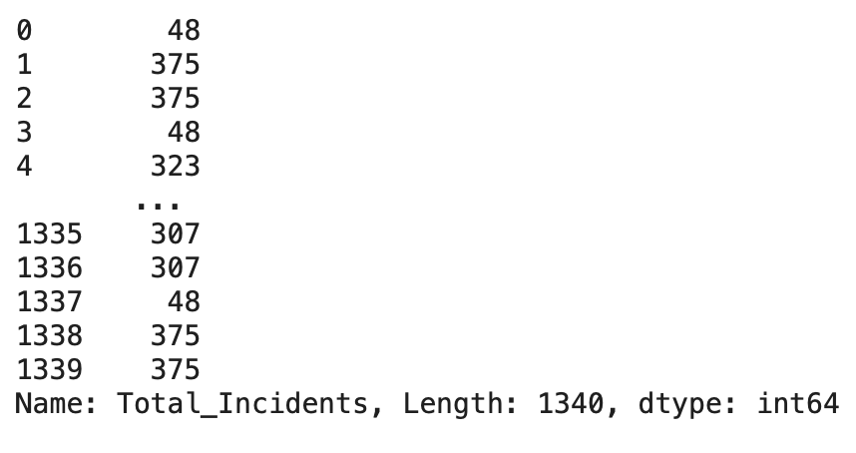
Feature Engineering (Additional)
Code Snippet
Crime Count by Borough
df['Total_Incidents_Borough'] = df.groupby('BORO_NM')['CMPLNT_NUM'].transform('count')
Explanation:
Grouped the data by borough (BORO_NM) and calculated the total number of crimes reported in each borough.
The result is stored in a new column Total_Incidents_Borough, which represents the number of crimes per borough.
Purpose: This feature allows us to analyze crime distribution across different boroughs, identifying areas with higher crime density.

Slide 43
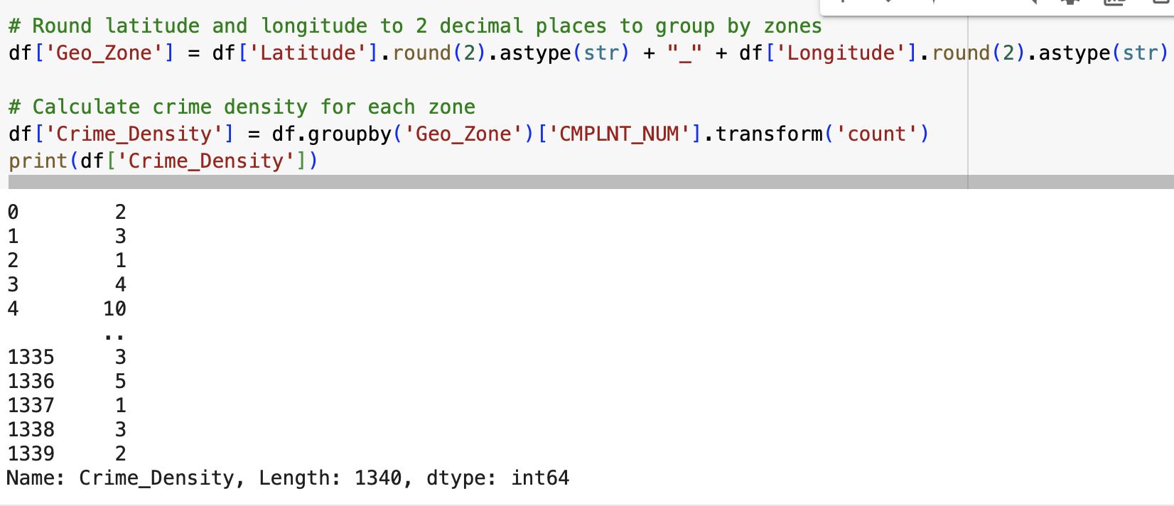
Feature Engineering (Additional)
Crime Density Based on Latitude and Longitude
Code Snippet
Explanation: Longitude and Latitude are rounded to two decimal places to group incidents by geographic zones (Geo_Zone).
The crime density for each zone is calculated by grouping the data by Geo_Zone and counting the number of incidents within each zone.
Purpose: This feature helps identify high-crime zones by providing a geographic view of crime density, which can aid in resource allocation to those areas.

Slide 44
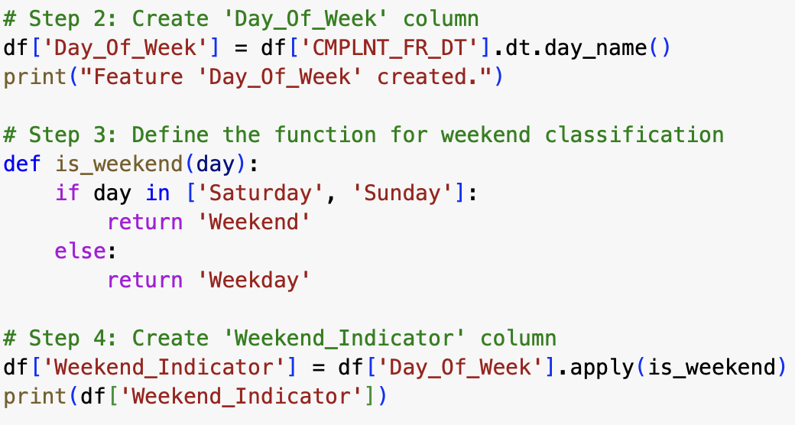
Feature Engineering (Additional)
Code Snippet
Weekend vs Weekday Classification
Explanation: A new feature Weekend_Indicator is created by applying a function that classifies each crime occurrence as happening on either a weekend or a weekday based on the Day_Of_Week column.
Purpose: This classification helps to analyze if crime rates vary based on the day of the week, which can inform resource allocation and scheduling for law enforcement.

Slide 45
File Handling
Explanation: Reading CSV File:
The dataset is read from the CSV file (NYPD_Complaint_Data_Historic.csv) into a Pandas DataFrame (csv_df) using pd.read_csv().
Exporting to Excel:
After processing the data, it is exported to an Excel file (output.xlsx) using csv_df.to_excel().
Setting index=False ensures that the DataFrame index is not included in the exported file, making it cleaner and easier to read.
Reading from Excel:
The newly created Excel file is read back into a DataFrame (output_df) using pd.read_excel(), demonstrating how to work with multiple file formats.
output_df.head() prints the first few rows of the newly loaded Excel file to confirm the successful export and re-import.

Slide 46
Error Handling
Explanation:
The try block attempts to read the dataset (NYPD_Complaint_Data_Historic.csv) using Pandas’ read_csv() function.
If the file is found, the first few rows of the dataset are displayed using data.head().
If the file is not found, a FileNotFoundError is raised, and the error message "File not found. Please check the file path." is displayed to inform the user.
Insights:
Error Handling ensures the program doesn’t crash when a file is missing.
The user is informed with a clear error message, making it easier to resolve file path issues.

Slide 47

Data Visualization
Data visualization aims to present complex crime data in a clear and accessible manner, helping the audience easily grasp patterns and trends across different boroughs and time periods. The goal is to provide a visual representation that enables effective analysis, highlighting key insights like crime distribution, temporal trends, and geographic hotspots, making the data more engaging and actionable for decision-making.

Slide 48
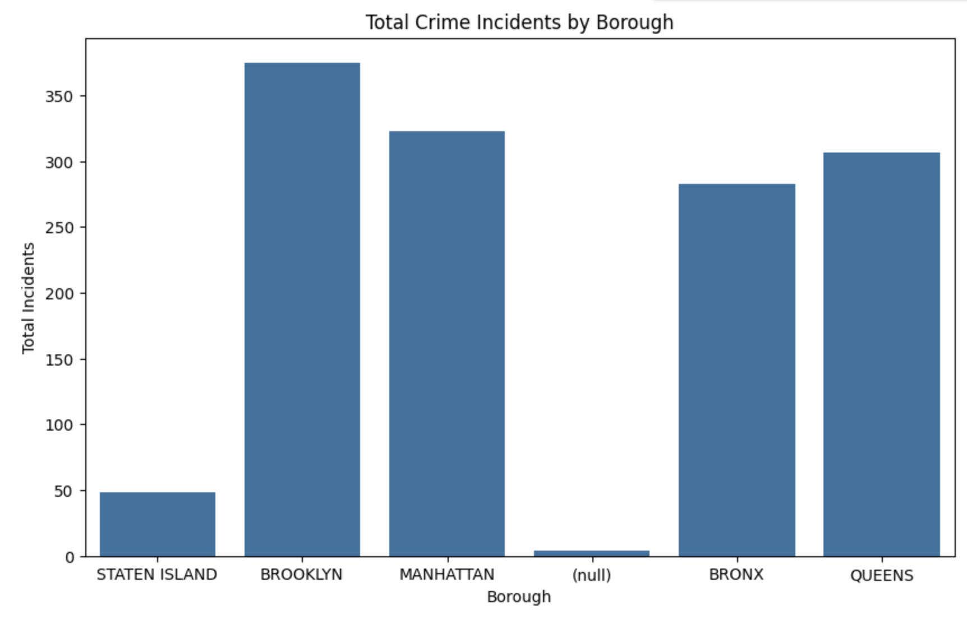
Observations: The bar plot shows that Brooklyn and Queens have the highest number of reported crimes, while Manhattan also shows a high frequency of incidents. Staten Island has the lowest crime count, indicating it may require less law enforcement attention compared to the other boroughs. Policy Recommendations: For High-Crime Boroughs (Brooklyn, Queens, Manhattan): •Increase police presence in high-crime areas during peak crime hours. •Establish more community-based policing programs to build relationships and trust. •For Low-Crime Boroughs (Staten Island): •Continue monitoring but allocate resources more efficiently to other boroughs.

Slide 49
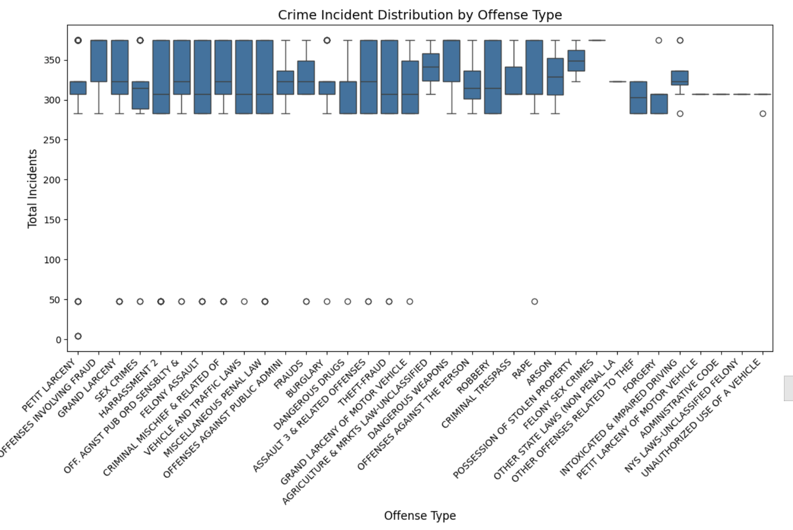

Slide 50
Crime Incidents by Offense Type
Larceny has a wide range of incidents, with many outliers indicating occasional spikes.
Assault and Fraud show a more consistent pattern in crime frequency.
Offense types like Robbery and Motor Vehicle Theft show a higher concentration of incidents at the median.
Policy Recommendations:
Larceny: Enhance surveillance in high-risk areas, such as commercial centers, to curb sudden spikes.
Assault and Fraud: Community engagement and public awareness campaigns about personal safety and fraud prevention.
Robbery and Motor Vehicle Theft: Increase vehicle protection programs and install more street cameras in identified hotspots.

Slide 51
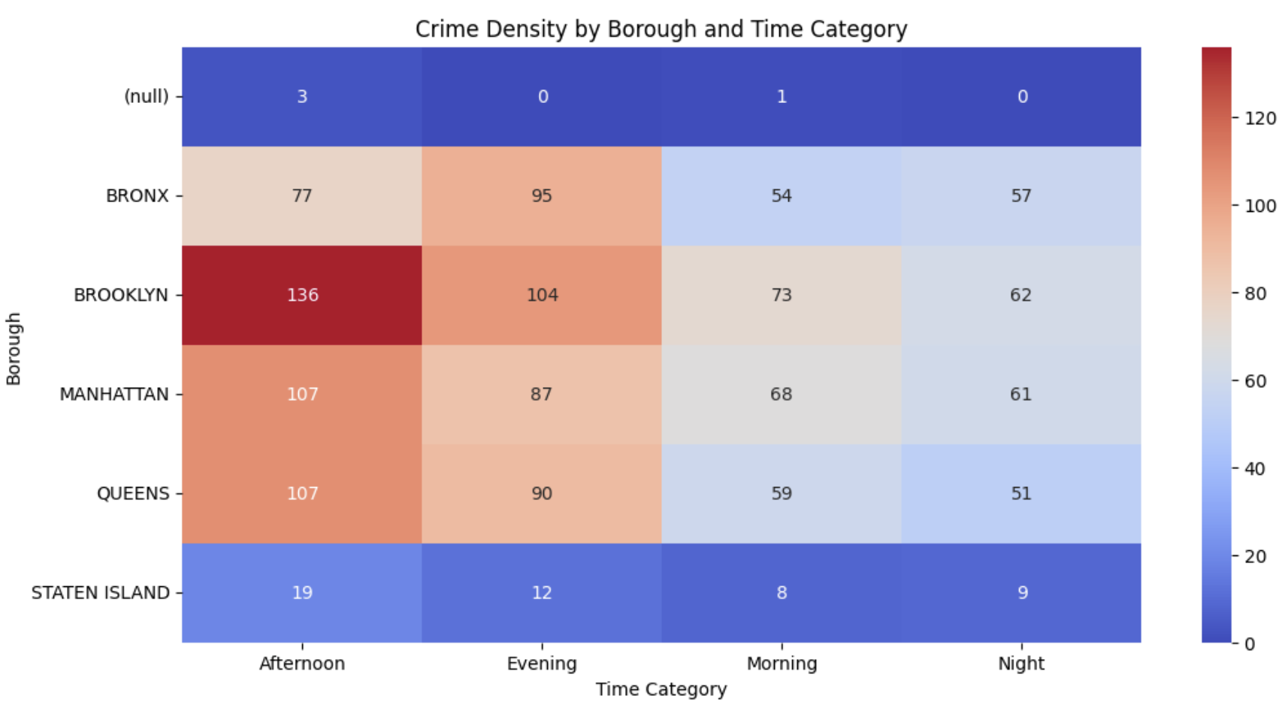

Slide 52
Crime Density by Time Category & Borough
Manhattan has the highest crime density during evenings and nights, particularly on weekends.
Brooklyn shows a significant spike in crime incidents on weekends, especially in the afternoon.
Queens sees a rise in crime in the morning and afternoon, possibly reflecting daytime activities or commute-related crimes.
Policy Recommendations:
Manhattan: Focus nighttime policing in areas with high nightlife activity. Collaborate with local businesses to ensure security measures are in place.
Brooklyn: Increase weekend patrols in public spaces, such as parks and malls, during the afternoon to manage crowd-related incidents.
Queens: Increase daytime surveillance to address crimes happening in the morning and afternoon, particularly in transit areas.

Slide 53
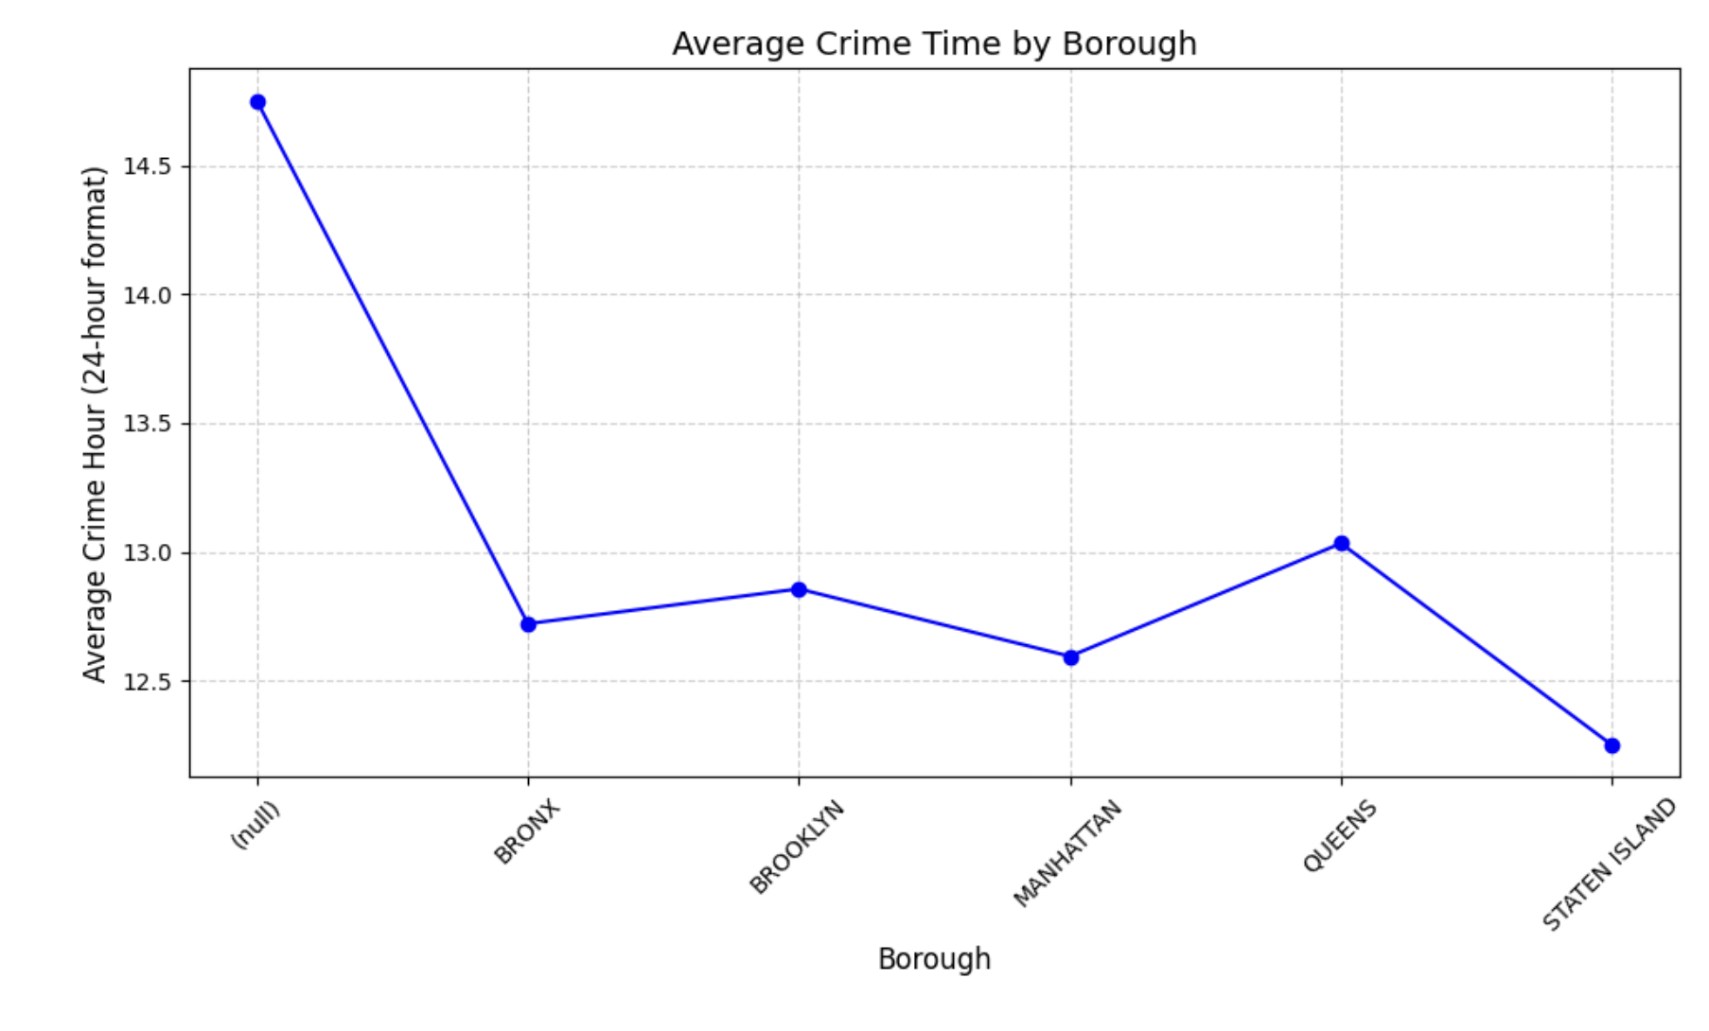

Slide 54
Crime Trend over Time ( Line plot)
Observations:
Crime incidents show clear seasonal fluctuations, with noticeable peaks in summer months and around holidays.
A gradual increase in crime rates during certain weeks could point to economic factors or specific public events.
Policy Recommendations:
During high-crime periods (e.g., summer or holidays), plan for increased police visibility and patrols in high-traffic areas.

Slide 55
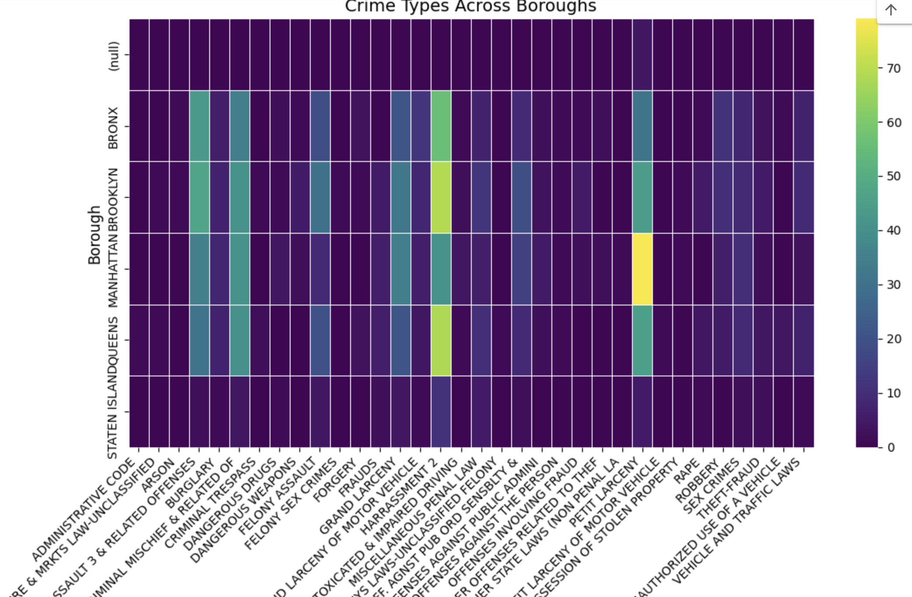

Slide 56
Crime Types Across Boroughs
Observations:
Larceny is the most frequent offense across all boroughs.
Robbery and burglary are prevalent in Manhattan and Brooklyn, indicating specific crime patterns.
Fraud shows consistent activity across boroughs but with lower intensity in suburban areas.
Policy Recommendations:
Larceny: Implement targeted crime prevention measures, such as shoplifting awareness and property protection.
Robbery and Burglary: Focus on high-risk neighborhoods with dedicated neighborhood watch programs and street lighting initiatives.

Slide 57
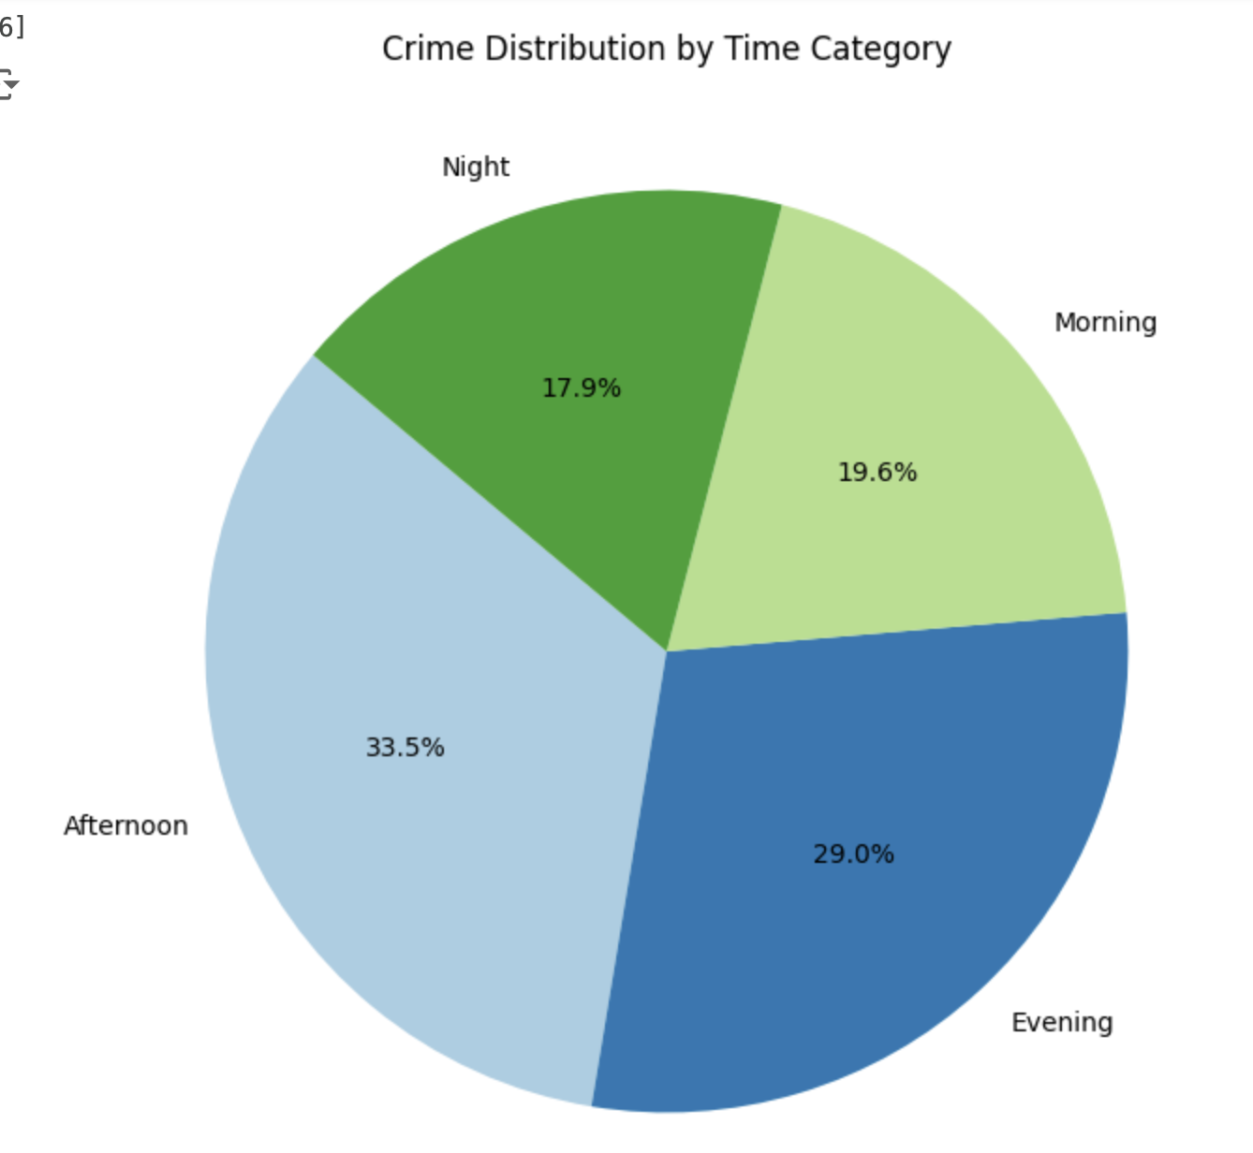

Slide 58
Crime Count by Time Category (Pie Chart)
Observations:
The highest number of crimes occurs in the evening and night time periods, especially over weekends.
Morning and afternoon show a lower concentration, indicating fewer crimes during work hours.
Policy Recommendations:
Increase night patrols and surveillance during the evening and night, when crimes are most prevalent.
Focus daytime preventive measures during commute hours, like traffic monitoring or public safety campaigns.

Slide 59

Questions to Answer
o What type of learning approach do you see? (Supervised, Unsupervised,
Reinforcement, or Semi-Supervised)
o How do you see the future scope of your solution?
o Justify your choice of approach with respect to your dataset and problem statement.

Slide 60
UNSUPERVISED LEARNING
⁠What type of learning approach do you see?
Based on the analysis conducted, the learning approach is unsupervised learning. This is because:
The focus is on discovering patterns and trends in the dataset rather than predicting a specific target.
The visualizations (crime counts by borough, offense types, etc.) are aimed at uncovering insights about the data itself, without predefined labels.

Slide 61
FUTURE STEPS
⁠How do you see the future scope of your solution?
The future scope of this solution involves several directions:
Predictive Modeling: Applying time-series forecasting models to predict future crime hotspots and crime trends based on historical data.
Real-Time Data Integration: Incorporating real-time crime data to continuously track and adjust law enforcement strategies and resources dynamically.
Geospatial Analysis: Utilizing machine learning techniques to better understand crime patterns in specific geographic regions, helping to allocate police resources more efficiently.

Slide 62
JUSTIFICATION
⁠Justify your choice of approach with respect to your dataset and problem statement
The unsupervised learning approach was chosen because:
The dataset is primarily used for exploratory data analysis (EDA), identifying trends, and visualizing crime patterns, without a specific target variable for prediction.
The goal is to uncover relationships between different variables (e.g., time, borough, offense type) to gain insights into crime distribution rather than to build predictive models.
By visualizing data through techniques like heatmaps, bar plots, and line plots, the approach effectively highlights patterns and anomalies in crime trends, which can be used for actionable policy recommendations.

Slide 63

Conclusion
Understanding the Dataset’s Role: This dataset from the NYPD captures detailed information on crime reports across New York City. It helps us understand crime patterns, providing insights that can guide law enforcement, policymakers, and researchers in making informed decisions.
Community Benefits: By highlighting where and when incidents are more likely to happen, this analysis supports smarter resource allocation for law enforcement. The ultimate goal is a safer city, where preventive strategies are based on real data, leading to more effective policing.

Slide 64

Future Steps & Recommendations
Advanced Data Analysis: Expand on this exploratory data analysis by diving deeper into predictive modeling. Using machine learning techniques, such as clustering or classification, could reveal hidden patterns in crime trends.
Further Dataset Exploration: Experiment with integrating additional datasets (like demographic data or social indicators) to provide a multi-dimensional analysis of crime.

Slide 65

Thank You

